Slide 1
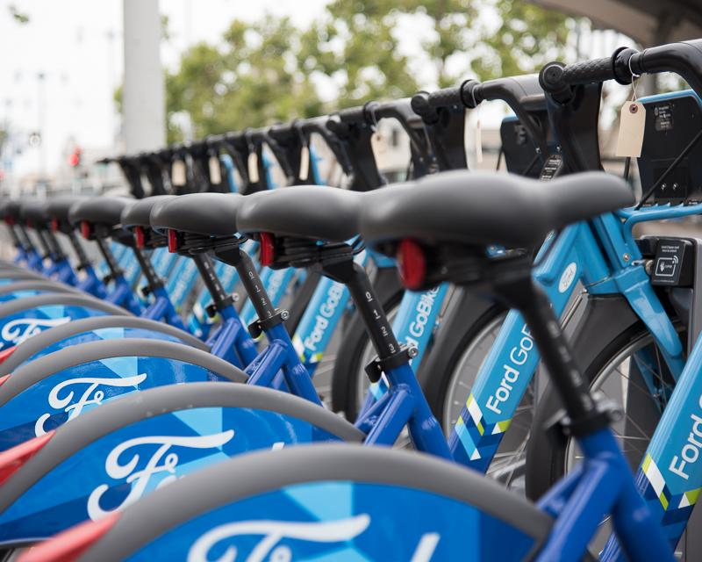

Bikeshare SF
the rise of shared transportation and recommendations around expansion
By: Kathy Wannaviroj, Hector Perez, Ricardo Rendon, Ksenia Chan, and Jarelly Martin
Notes:
kathy

Slide 2

Agenda
1
What is Bike-sharing?
2
Goal: Expansion in SF
3
Background about Bay Wheels
4
Rise of Bike Share + Analysis
5
Expansion Recommendations
6
Sources
Notes:
kathy
Add agenda
First we will talk about what bikeshare is (why people ride/background)
Second we will discuss the goal of the project is centered around expansion
Third we will talk provide background about baywheels
Details (types of bikes, prices)
Fourth present analysis of bikeshare and rise of bikeshare
Finish up by giving recommendations

Slide 3
What is Bike-sharing?
Notes:
JARELLY

Slide 4



Bike-sharing is public service where individuals can rent a bike for a short-term with a fee ($)
Available across the major U.S. cities such as Washington D.C., New York, and San Francisco.
Number of public-use bicycles is only increasing, 45.5 million bike trips in the U.S. in 2018 in comparison to 28 million in 2016.
Source: NACTO
Notes:
JARELLY https://nacto.org/shared-micromobility-2018/

Slide 5
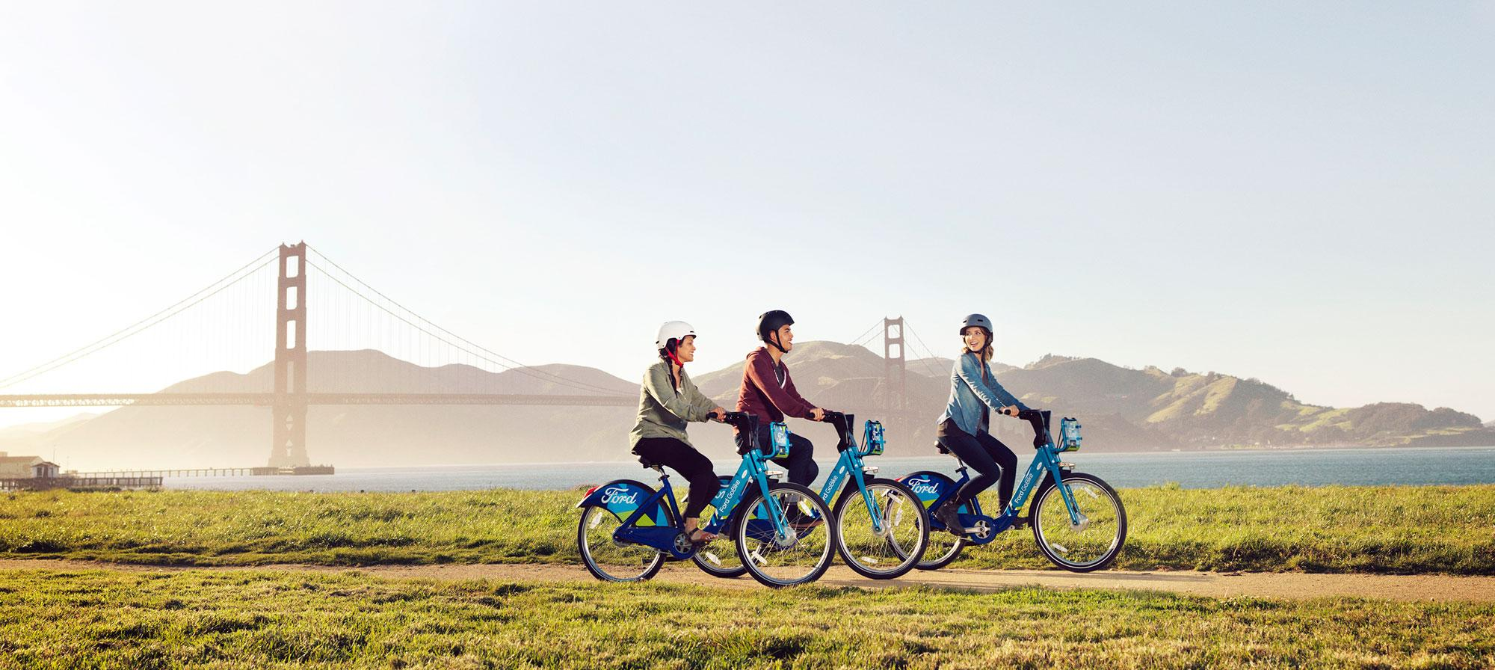
San Francisco named second most bike friendly city in the U.S.
According to the U.S. Census, the 2016 ranking shows that San Francisco has made bikes a priority.
Chicago
San Francisco
Portland
New York City
Seattle
Source: Curbed SF
Notes:
KSENIA compare to US cities
https://sf.curbed.com/2016/9/19/12982284/sf-bike-friendly-city-cycling
https://sf.curbed.com/2020/5/21/21266623/san-francisco-slow-streets-closures-where-sf

Slide 6
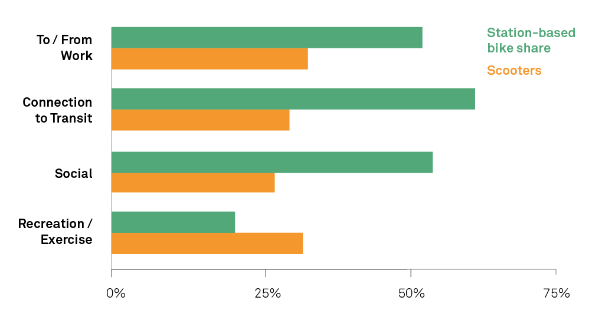
Why do people ride?
The analysis shows evidence of big demand for e-bikes.
Classic bike share is mostly used for commuting or transit connections.
Bike share can help with the use of public space to increase active mobility.
Source: NACTO
Notes:
HECTOR
https://sf.streetsblog.org/2019/04/17/scooter-trips-surpass-bike-share-for-the-first-time/

Slide 7
Goal:
Expansion in SF
Notes:
HECTOR

Slide 8


Goal: Provide the mayor’s office with recommendations as to where to expand Bay Wheels stations in the city of San Francisco.
Main Priority: Ensure everyone has access to transportation.
Notes:
HECTOR

Slide 9

Background about
Notes:
JARELLY

Slide 10
San Francisco
Bike-sharing program started in 2013 through the San Francisco Municipal Transportation Agency (SFMTA). Also serves the East Bay and San Jose.
Lyft
Bay Wheels is available on the Lyft app for single trip usage or for those apart of the membership program.
Bikes
Bay Wheels provides both electric and non-electric bikes that are either in docks or stationless.
Equity
20% of bike stations are located in low-income neighborhoods and the Bike Share for All program provides affordable membership prices for those that qualify.
Source: SFMTA
Notes:
JARELLY

Slide 11
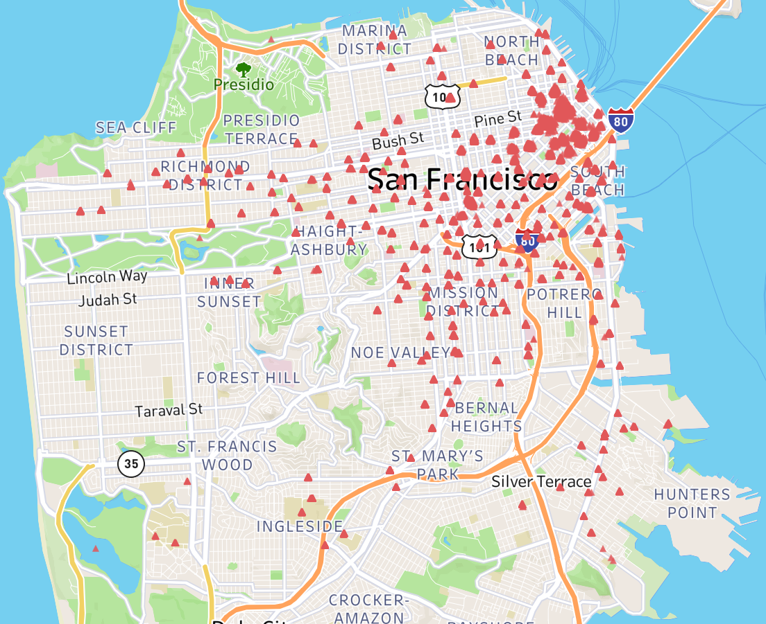
There are a total of 280 stations.
Every represents a distinct Bay Wheels station in SF.
Notes:
JARELLY

Slide 12
Vehicle Types, Usage & Pricing
Notes:
KATHY

Slide 13
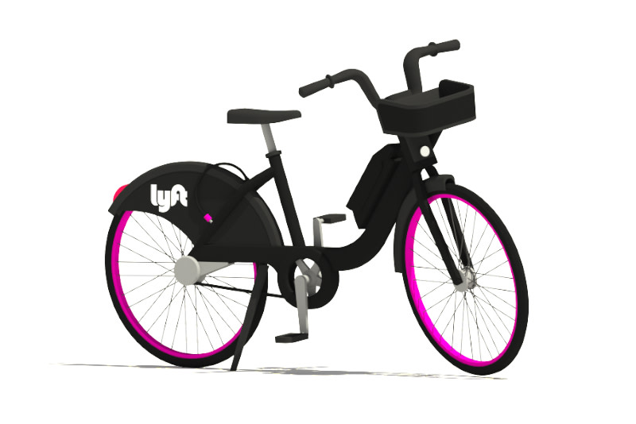
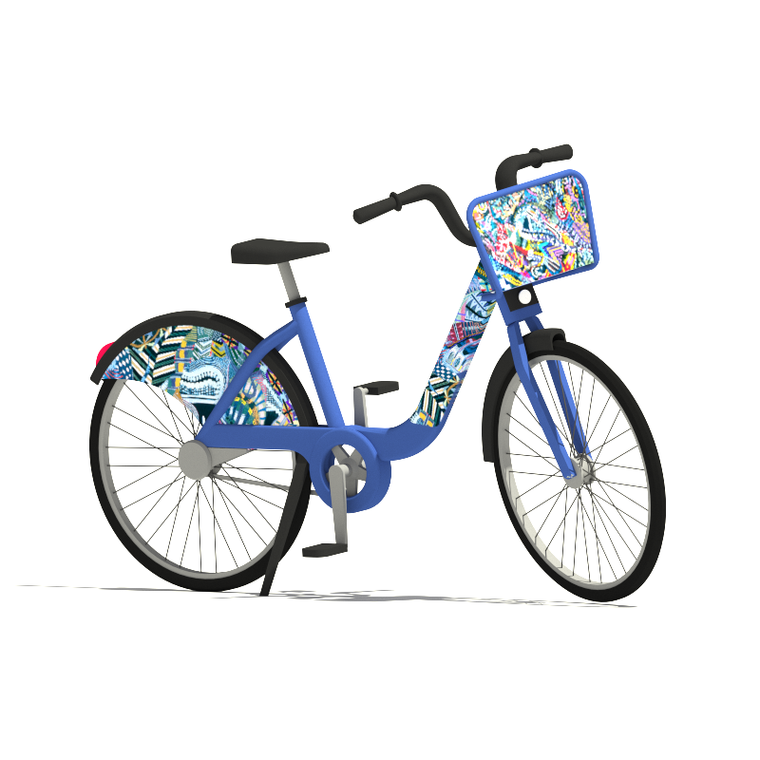
What are ebikes v. classic bikes?
Ebikes: electric-assist bicycles, pedal assist for the hills, dockless mode in which riders can lock the bike to any bike rack with a built in lock
Classic Bikes: Classic pedal bike, non-electric, available only at docks
Source: Lyft, Bay Wheels
Notes:
KATHY

Slide 14
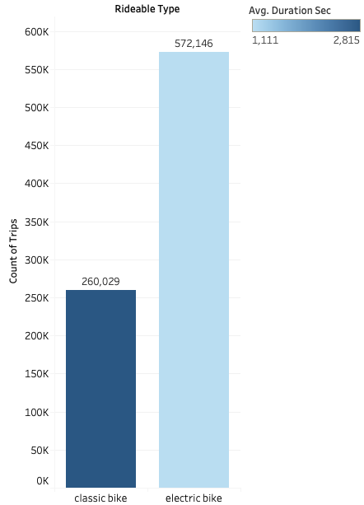
How does usage differ by vehicle type?
Based on this graph it shows more riders prefer electric bikes over classic
The average duration in seconds (lighter the color the shorter the trip v. the darker the color the longer the trip)
Notes:
KATHY
Expansion - add more electric bike stations, more popular,

Slide 15
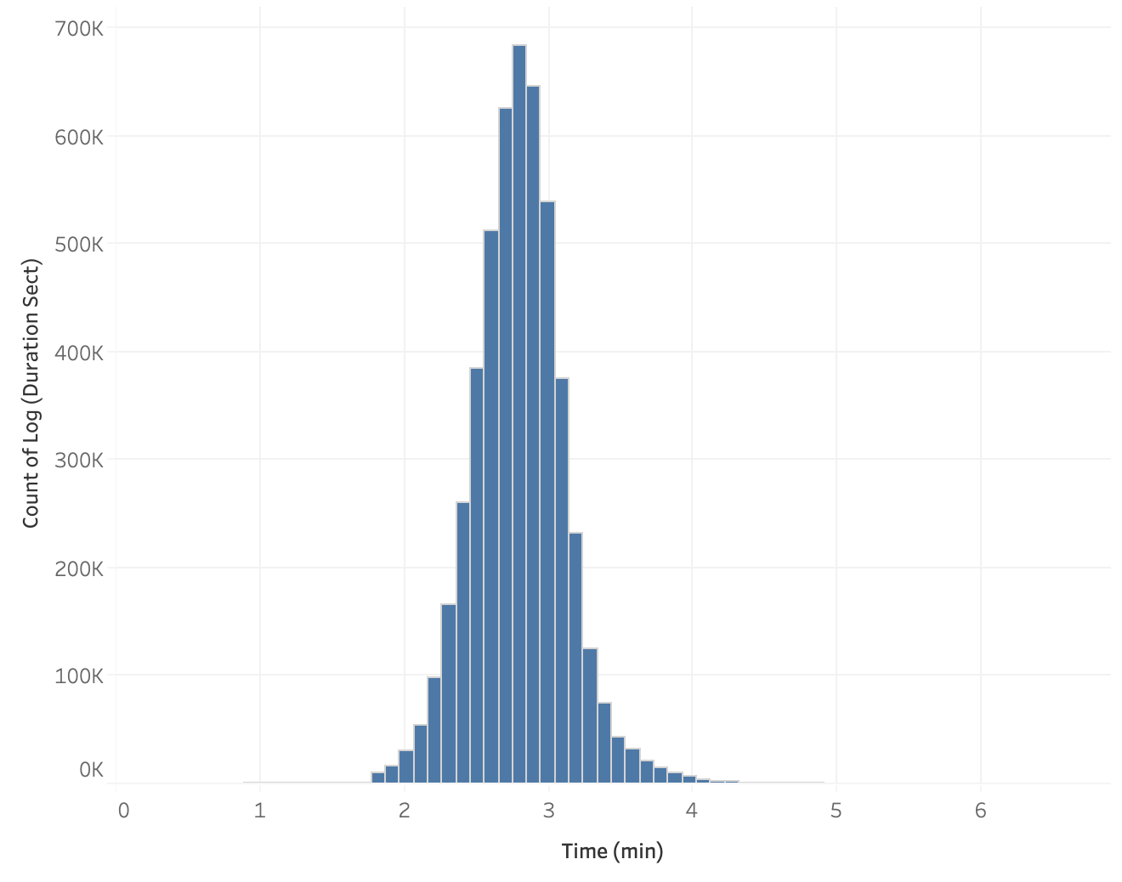
Bike Trip Duration
Majority of bike trips are relatively short where they fall closer to 1,000 sec = ~16 min
Users are taking shorter trips → using bike-sharing to get to/from work and accessing other public transportation
Number of Bike Trips
Not many trips here
Or here
10
100
1000
10000
Time (sec)
Notes:
JARELLY
log(100) = 2 → 100 seconds
log(1000) = 3 → 1000 seconds = 16 min
log(10000) = 4 ---> 10,000 seconds = 166 min

Slide 16
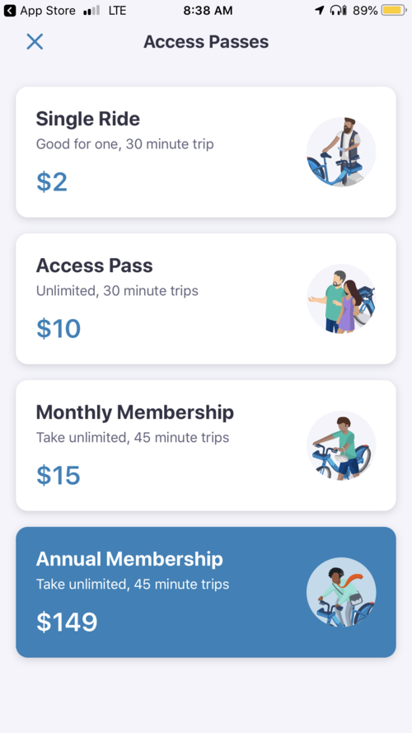
Bike Share Price
A reduced pricing option, Bike Share for All, exists for users who qualify for government assistance programs. The reduced price is $5/year for the first year and $5/month in subsequent years.
As of January 2018, around 15% of members used the Bike Share for All option.
Source: Lyft, Bay Wheels
Notes:
KSENIA price history

Slide 17
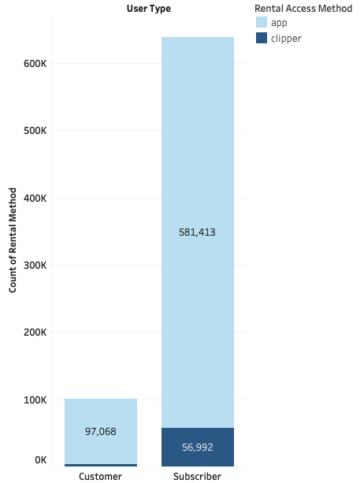
User Type & Rental Method
This graph shows the amount of users on bike share and the rental method they used (Lyft app v. Clipper card)
It also shows whether the user is a customer (one time user) or subscriber
Notes:
KATHY
Bikeshare should have a partnership with clipper so more people use bikesharing

Slide 18
Competing Markets
Notes:
HECTOR

Slide 19



Bike Sharing Market in San Francisco
Prominent Players
Adopting Strategies
New
Acquisitions
To combat competition companies are adopting strategies collaborations & partnerships or merger & acquisitions to expand their business operations.
In July 2018, Lyft acquired, Motivate, a San Francisco based company.
Source: Global Market Insights, SF Examiner
Notes:
HECTOR
https://www.gminsights.com/industry-analysis/bike-sharing-market
https://www.sfexaminer.com/news/lyft-corners-temporary-bikeshare-monopoly-in-san-francisco/
In July 2018, Lyft aquired, Motivate, a San Francisco based company. This helped Lyft to enhance their business operations by making large investments for the development of new bike stations and adding new bikes to the fleet to expand their reach

Slide 20
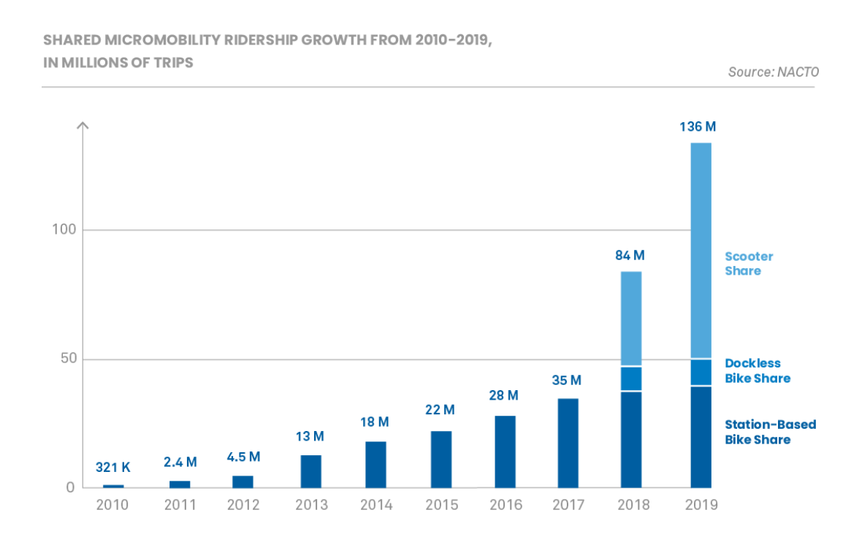
Shared Micro-Mobility Growth
In 2019, people took over 40 million trips on station- based bike share systems, pedal and e-bikes.
Between 2018 and 2019 bike share grew roughly 10%.
Scooter trips, more than doubled over the same period of time.
Source: Streetblogs USA
Notes:
HECTOR
https://usa.streetsblog.org/2020/08/31/micromobility-trips-explode-60-percent-in-one-year-but-bikeshares-lag/

Slide 21
Rise of Bike-sharing + Analysis
Notes:
RICARDO

Slide 22
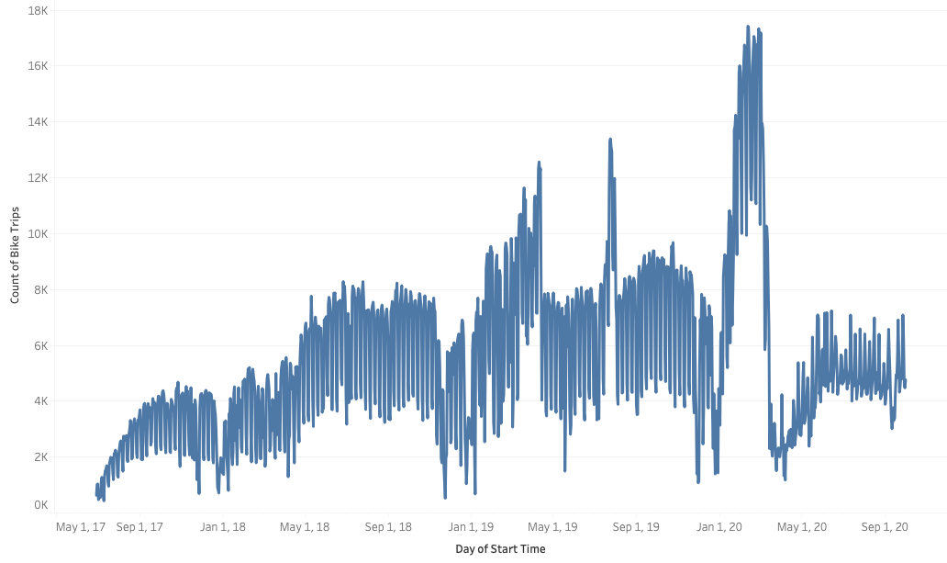
Bike-sharing in SF
Notes:
RICARDO

Slide 23
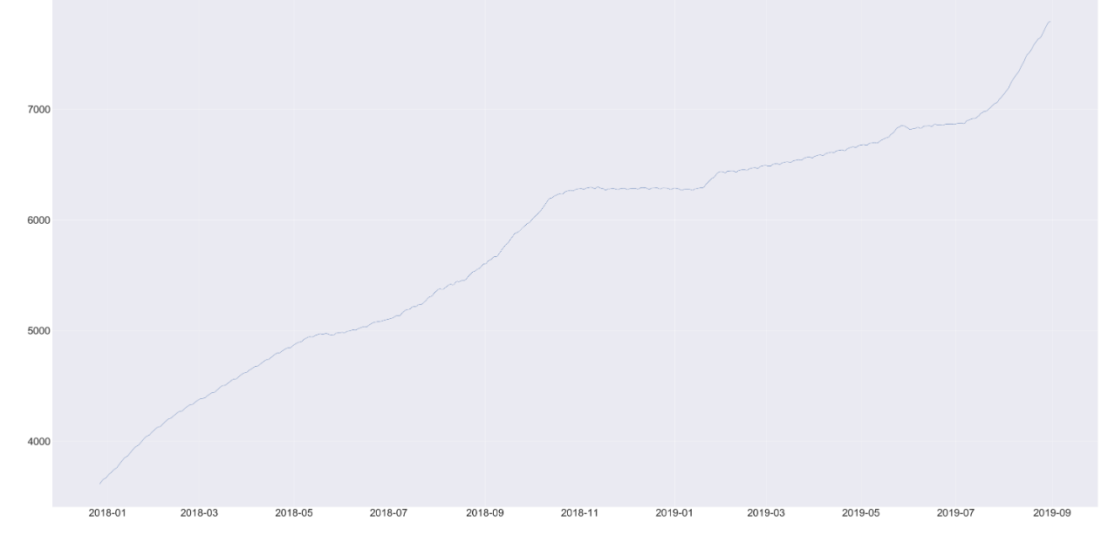
Increase in Bike-sharing
Number of Bike Trips
Date
Notes:
Ricardo

Slide 24

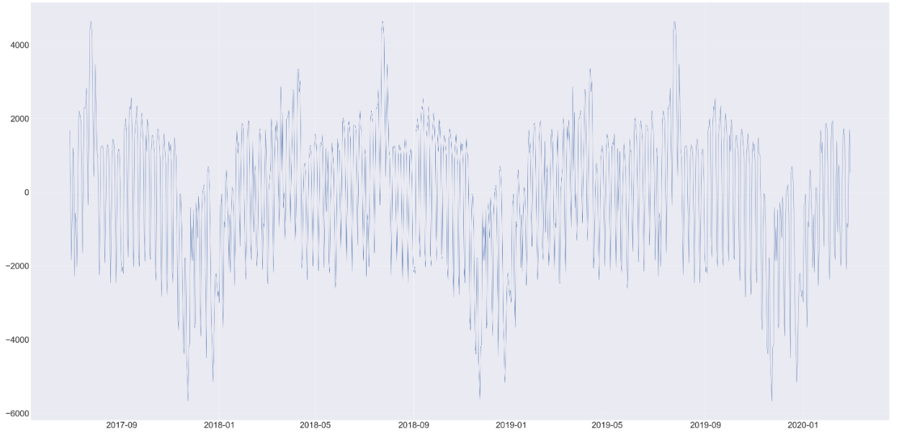
Seasonality
Peak between March and August
Drop between December and January
Notes:
Ricardo
Add axis

Slide 25
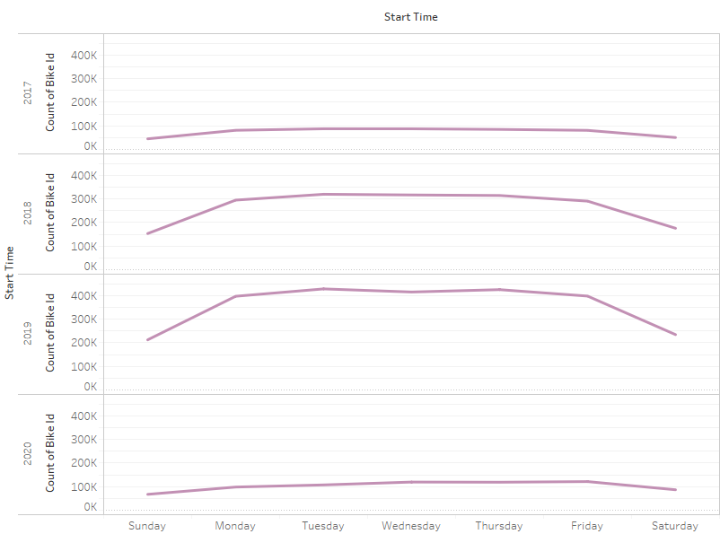

Amount of Rides per Weekday
Day of the Week
Amount of rides per year
LOW due to lack of information in year 2020 (Jan-Mar)
Notes:
RICARDO

Slide 26
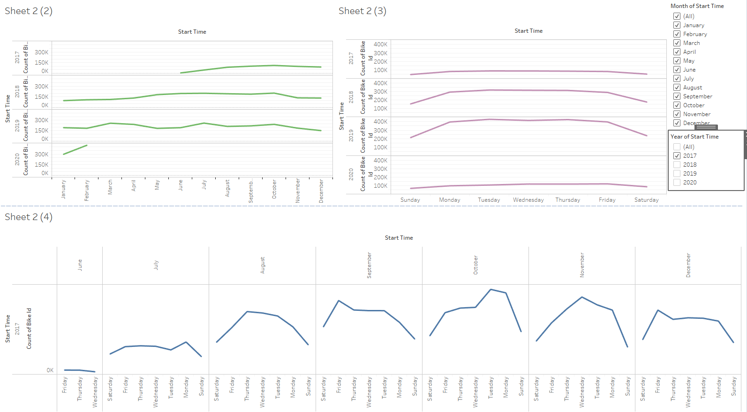
Amount of Rides per Month
Month
Peeks in October (good weather)
Lowest point in December and January (holiday season)
Number of Bike Trips
Notes:
RICARDO
Reference peak period promotions (holiday season) convert one time users

Slide 27
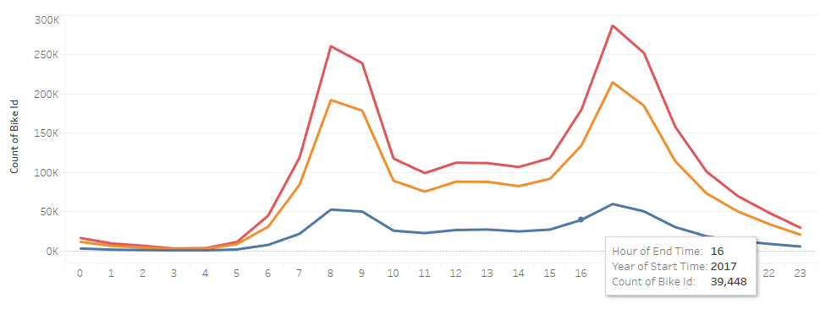
Hourly Trend
2017
2018
=
Peaks between 6am-10am and 4pm-8pm
2019
Number of Bike Trips
Hour (military time)
Notes:
JARELLY

Slide 28
COVID-19:
Impact on Bike-sharing
Notes:
HECTOR

Slide 29
Bikesharing in SF after COVID-19
COVID-19
Shelter-in-Place
Notes:
KSENIA

Slide 30
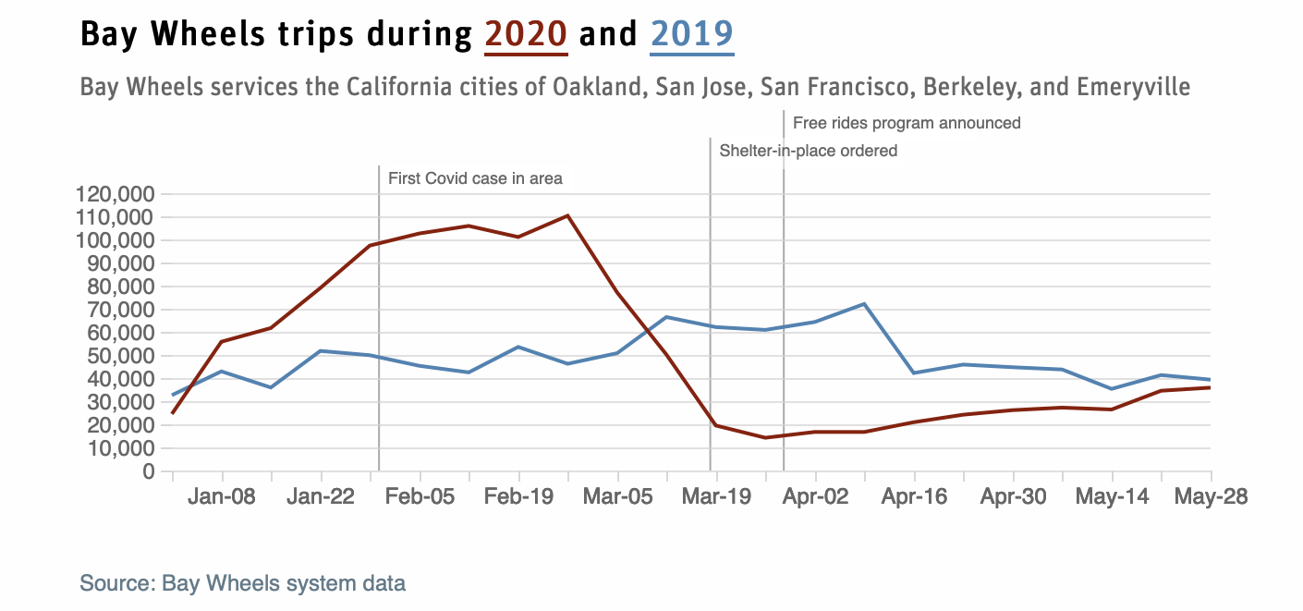
COVID-19 Impact on Ridership
March 17th - Bay Area announced shelter-in-place order
March 27th - Bay Wheels announced a one-month free-rides program for healthcare workers
On April 28th it extended the program for another month
Notes:
KSENIA
https://citymonitor.ai/transport/the-decisions-cities-made-about-coronavirus-had-a-big-impact-on-bike-share-ridership

Slide 31
So, How Much $$ did Bay Wheels Lose due to COVID-19?
Let's predict the amount of rides from March (when covid started) to the present based on only pre-COVID data.
This will help us understand the number of rides lost once we subtract the predicted data with the actual data, what happened after COVID-19.

Slide 32
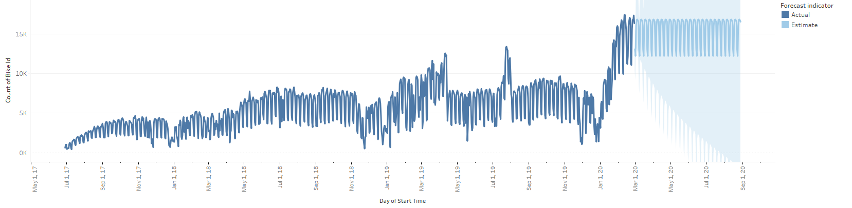
Forecasting in Tableau
Actual
Estimate
Notes:
ricardo

Slide 33
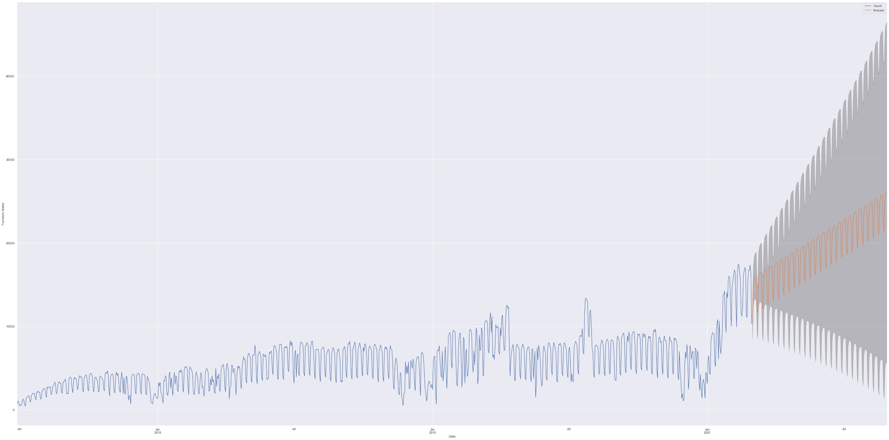
Forecasting in Python
Available data
Forecast
20,000
10,000
Number of Bike Trips
5000
3000
1000
0
July 17
Jan 18
July 18
Jan 19
July 19
Jan 20
July 20
Jan 21
Date
Notes:
RICARDO

Slide 34
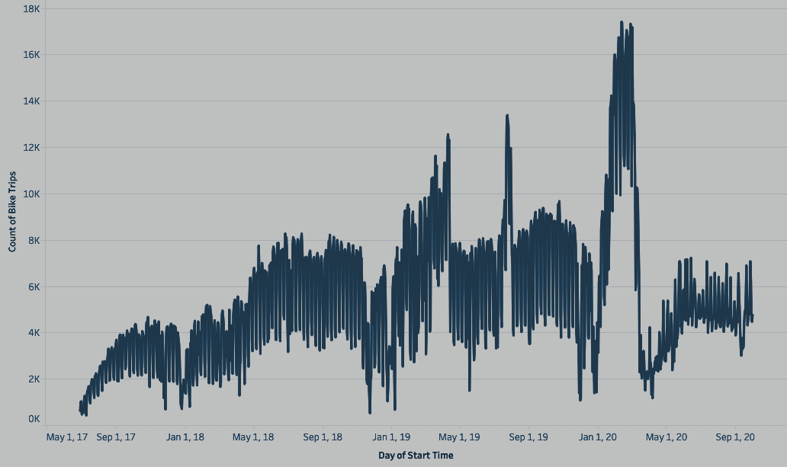
Loss due to COVID: 12k Rides per day
Available data
Forecast
20,000
15,000
Number of Bike Trips
10,000
5000
3000
1000
0
July 17
Jan 18
July 18
Jan 19
July 19
Jan 20
July 20
Jan 21
Date
Notes:
RICARDO

Slide 35
Let's break it down:
There are 12k rides per day* with $3.70 avg. revenue per ride=$45k per day.
Data available: until September 2020
Projected loss (from March to September): $7,380,000
Source: CFO DIve, The Verge
Notes:
RICARDO
https://www.cfodive.com/news/dockless-scooters-profitability-forecast-lime-bird/568041/#:~:text=3.49%20rides%20per%20scooter%20per,charged%20in%20Louisville%20last%20year.
https://www.theverge.com/2020/5/13/21257307/electric-scooter-bikeshare-covid-19-bird-lime-uber-subsidies

Slide 36
Facebook Prophet Algorithm:
At its core, the Prophet procedure is an additive regression model with four main components:
A piecewise linear or logistic growth curve trend. Prophet automatically detects changes in trends by selecting changepoints from the data.
A yearly seasonal component modeled using Fourier series.
A weekly seasonal component using dummy variables.
A user-provided list of important holidays.

Slide 37
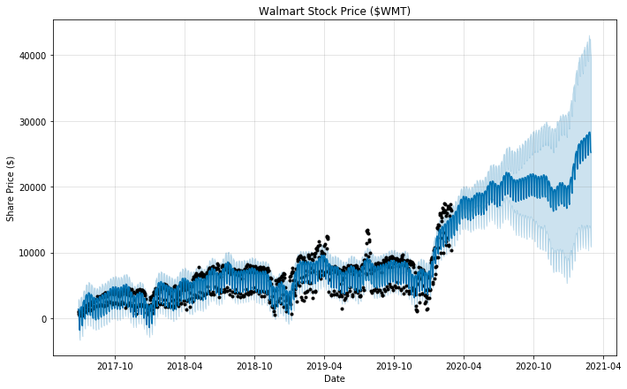
Prophet Algorithm Forecast

Slide 38
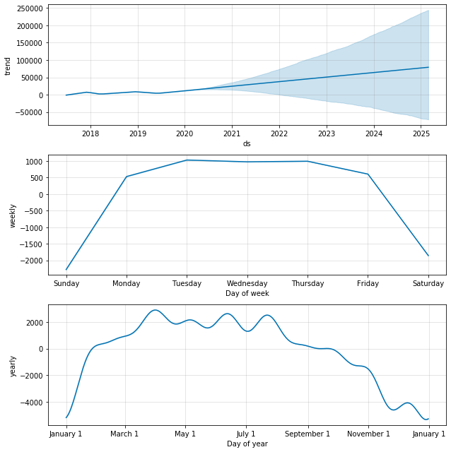

Slide 39
Expansion Recommendations
Notes:
JARELLY

Slide 40
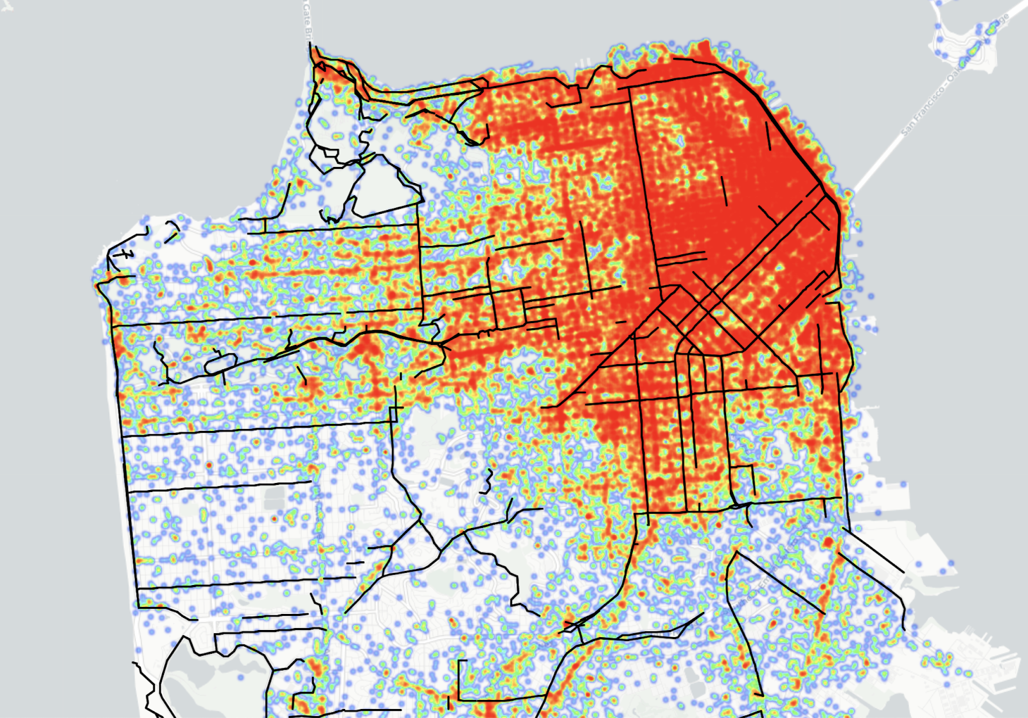
Bike Share v. Scooter Share
Bike share is in red, while scooter share is in green and bike lanes are in black
This map further supports our goal of expansion in Districts 1, 2, and 4
Source: Medium
Notes:
HECTOR
https://medium.com/@skipscooters/skip-survey-insights-how-san-francisco-rides-9049ce34f28c

Slide 41
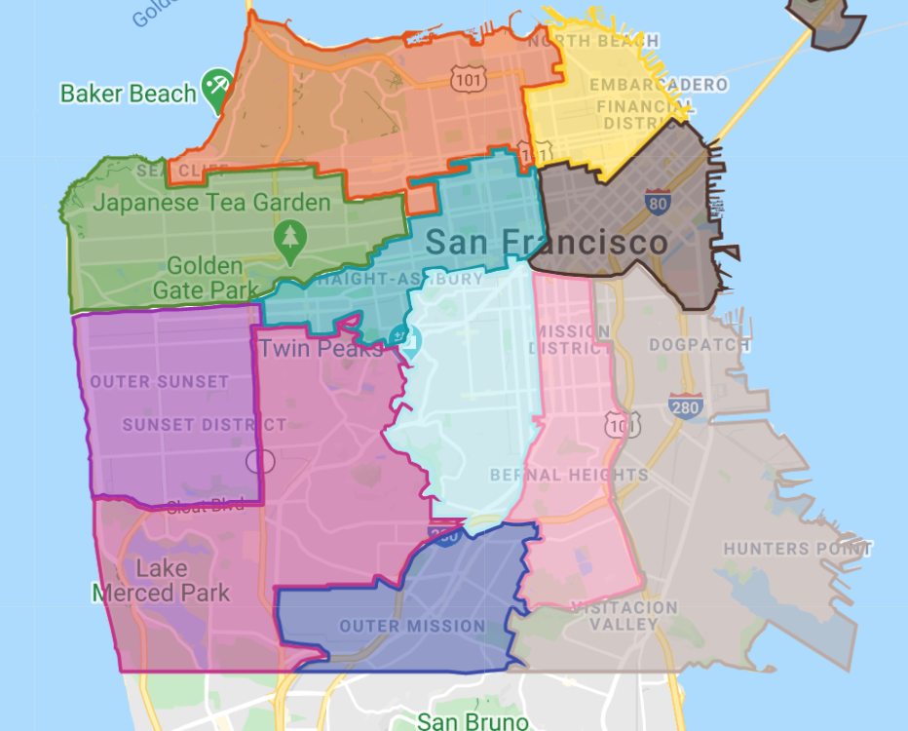
Bike Stations by District
District 1
District 2
District 3
District 4
District 5
District 6
District 7
District 8
District 9
District 10
District 11
Less bike-sharing stations are available in Districts 1, 2, and 4 which are residential areas and home to very popular tourist locations.
Notes:
JARELLY
Main Priority: Make sure everyone in the city has access to transportation (residents, tourists, etc.)

Slide 42
Recommendations
District 1: Add stations near prominent tourist attractions in this area (Lands End, Legion of Honor, Golden Gate Park)
District 2: Add stations in Presidio area and neighborhoods (ride to Golden Gate Bridge, Fort Mason, Crissy Fields, etc.)
District 4: Add stations in residential area (ride the great highway, SF Zoo, commuting to work/rest of the city)
2
1
4
Notes:
KATHY

Slide 43
Sources
https://nacto.org/shared-micromobility-2018/
https://sf.streetsblog.org/2019/04/17/scooter-trips-surpass-bike-share-for-the-first-time/
https://www.gminsights.com/industry-analysis/bike-sharing-market
https://www.sfexaminer.com/news/lyft-corners-temporary-bikeshare-monopoly-in-san-francisco/
https://usa.streetsblog.org/2020/08/31/micromobility-trips-explode-60-percent-in-one-year-but-bikeshares-lag/
https://medium.com/@skipscooters/skip-survey-insights-how-san-francisco-rides-9049ce34f28c
https://sf.curbed.com/2016/9/19/12982284/sf-bike-friendly-city-cycling
https://www.sfmta.com/getting-around/bike/bike-share#Overview
https://www.lyft.com/bikes/bay-wheels/meet-our-bikes
https://www.lyft.com/bikes/bay-wheels/pricing
https://citymonitor.ai/transport/the-decisions-cities-made-about-coronavirus-had-a-big-impact-on-bike-share-ridership
https://www.cfodive.com/news/dockless-scooters-profitability-forecast-lime-bird/568041/#:~:text=3.49%20rides%20per%20scooter%20per,charged%20in%20Louisville%20last%20year.
https://www.theverge.com/2020/5/13/21257307/electric-scooter-bikeshare-covid-19-bird-lime-uber-subsidies
https://en.wikipedia.org/wiki/San_Francisco_Municipal_Transportation_Agency

Slide 44
Questions?
Notes:
JARELLY - add picture

